Slide 1

Cab Management System
Team 6
Rutuja Nitin Mandlik
Nikita Singh
Mandar Deshmukh
Manita Pasi

Slide 2


Contents
Objective​
ER Diagram​
Server-side Modules​
Views, Reports and Analysis​
Contribution

Slide 3

Objectives
Cab Database Management System is aimed at maintaining data related to driver management, vehicle management and overall information about the cab trip.
This application can be used for administrative and operational analysis required for managing a Cab Service Management.

Slide 4
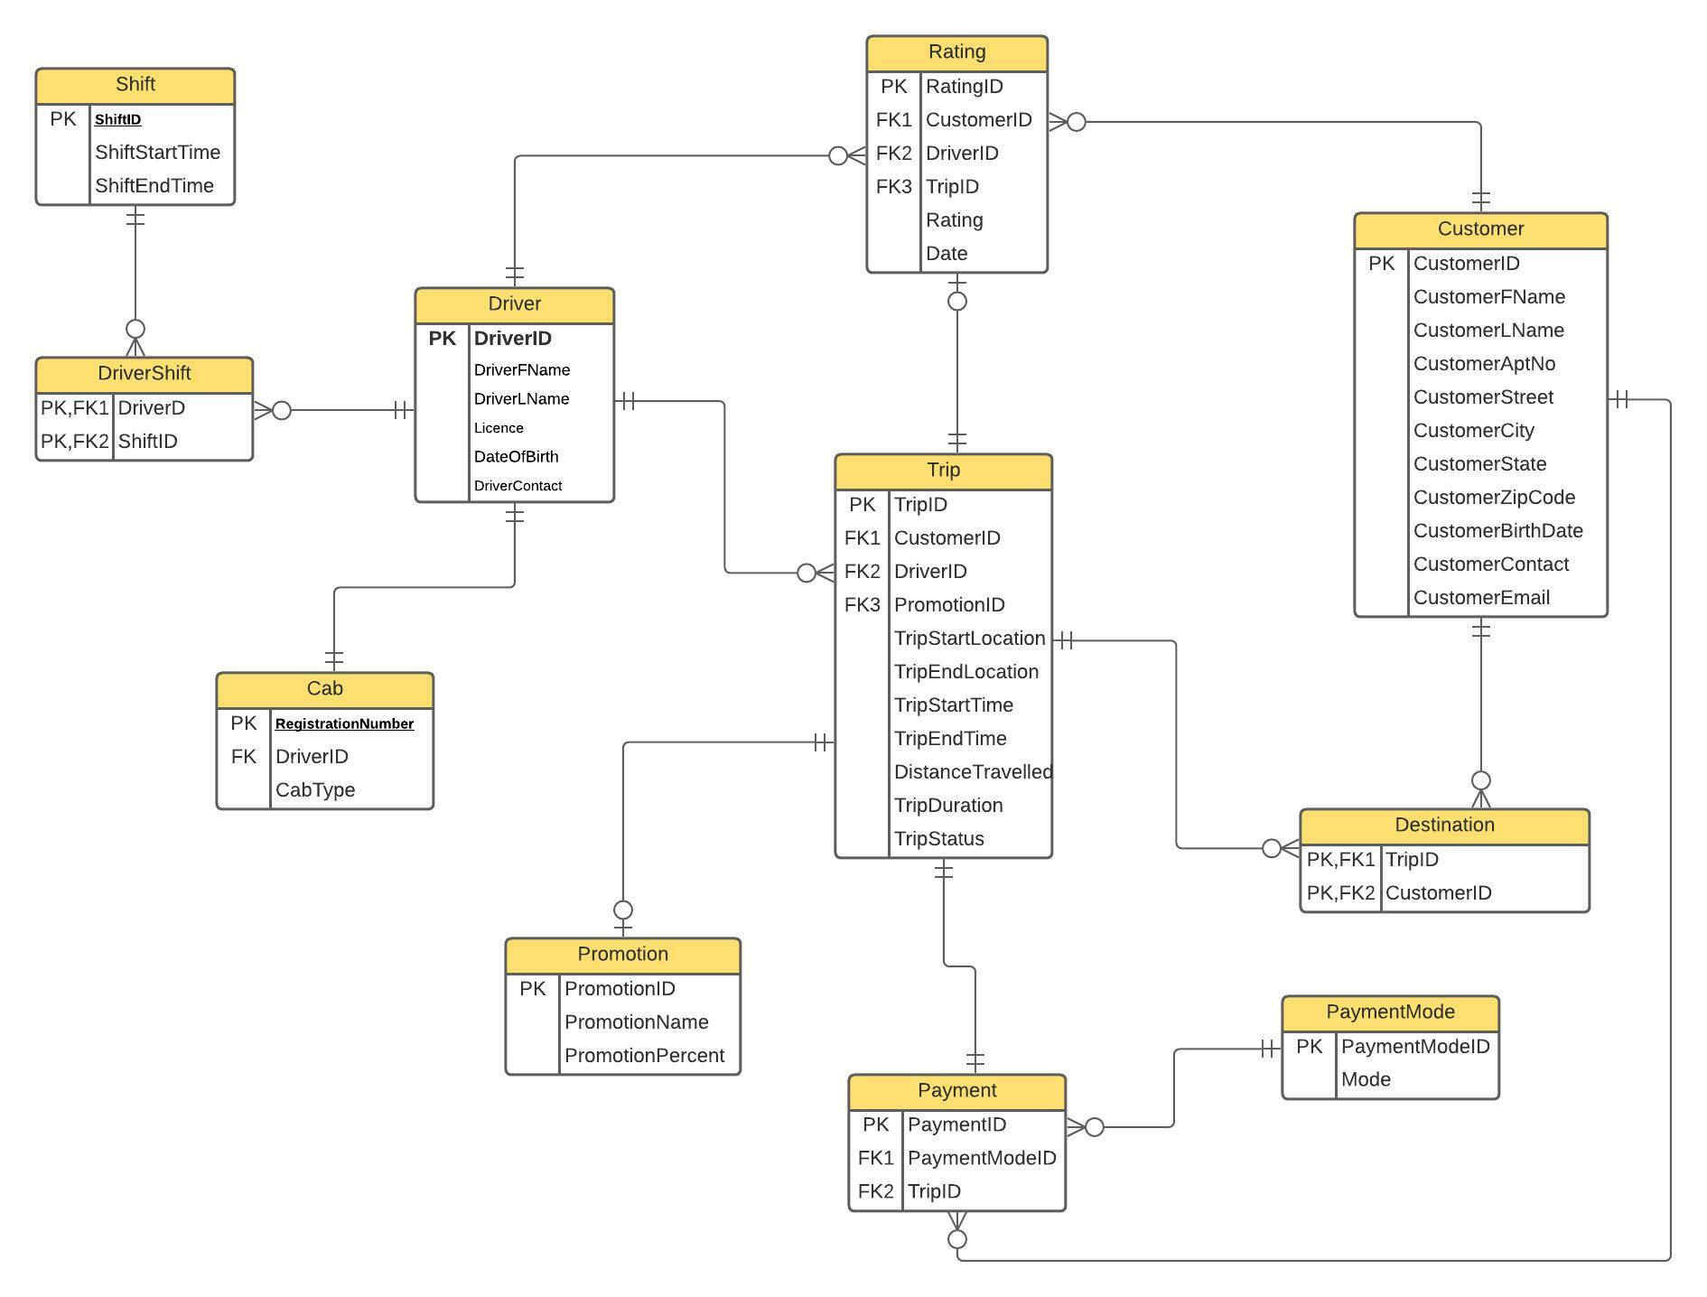
ER diagram

Slide 5
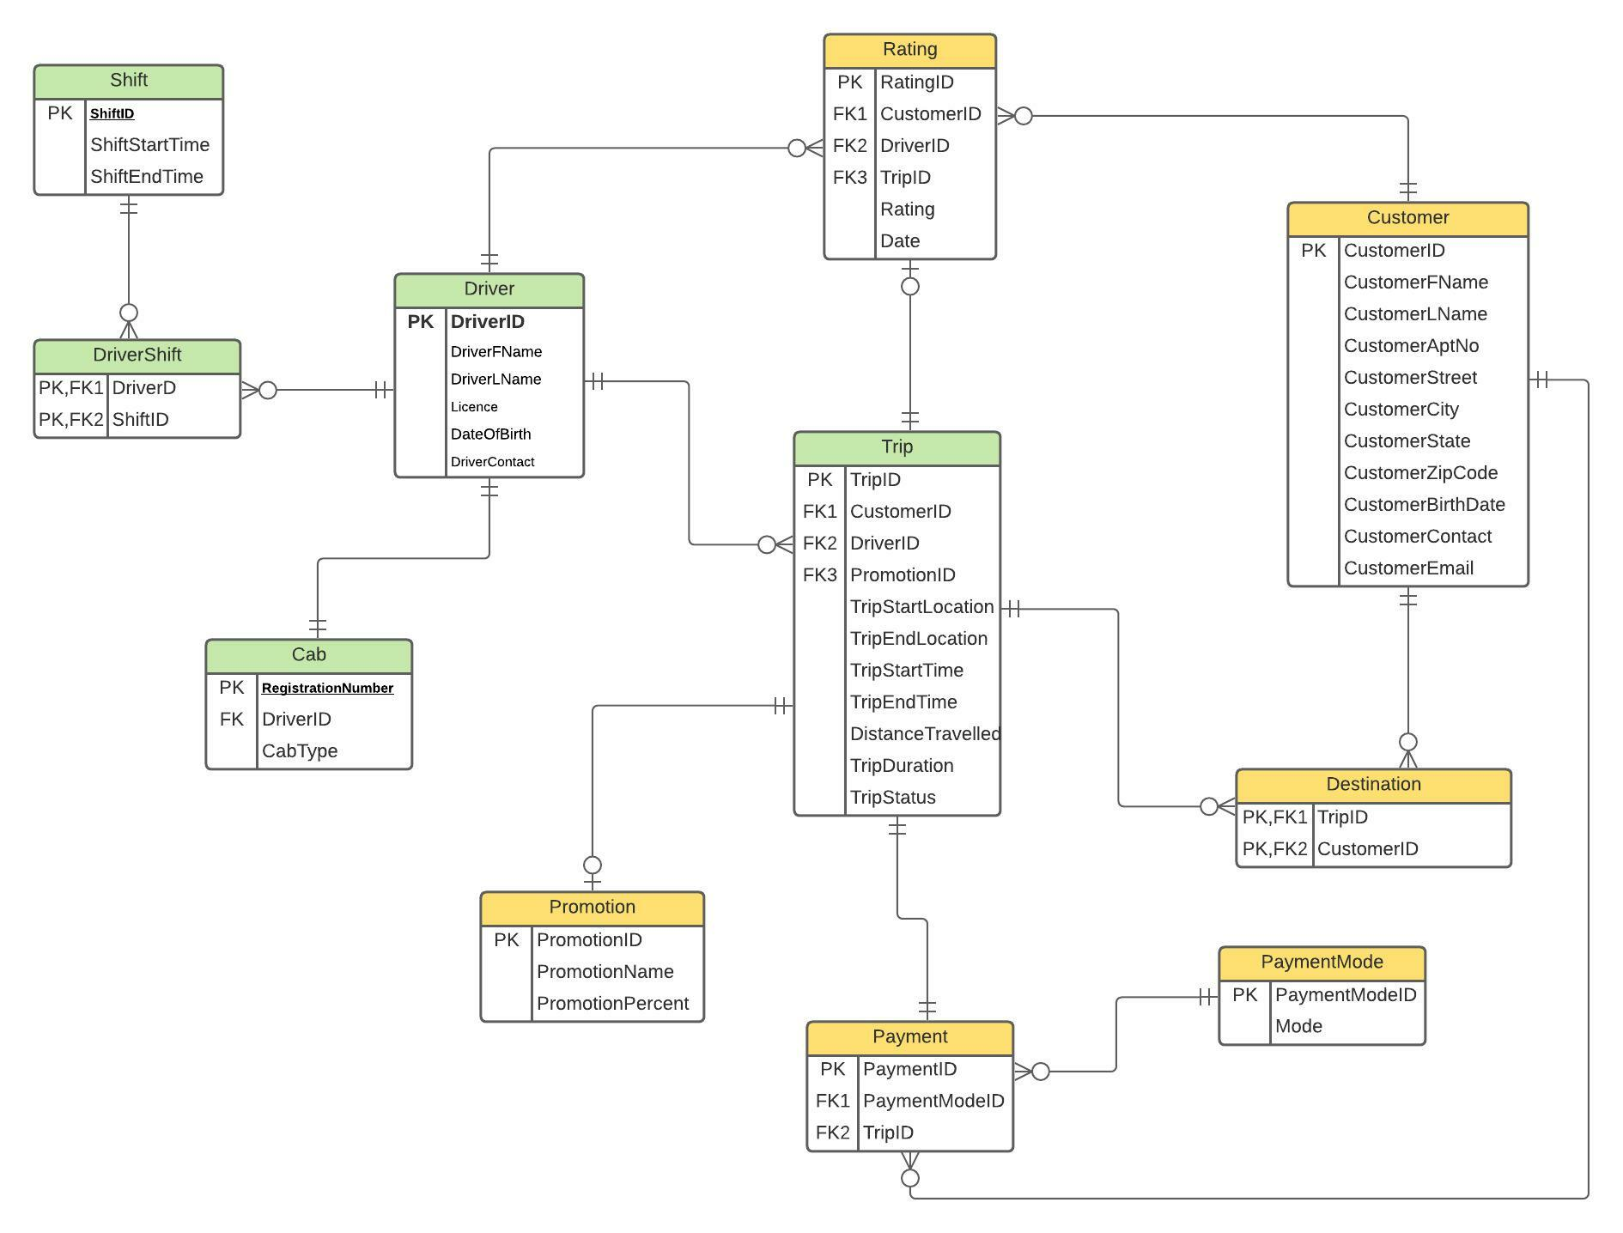

Slide 6
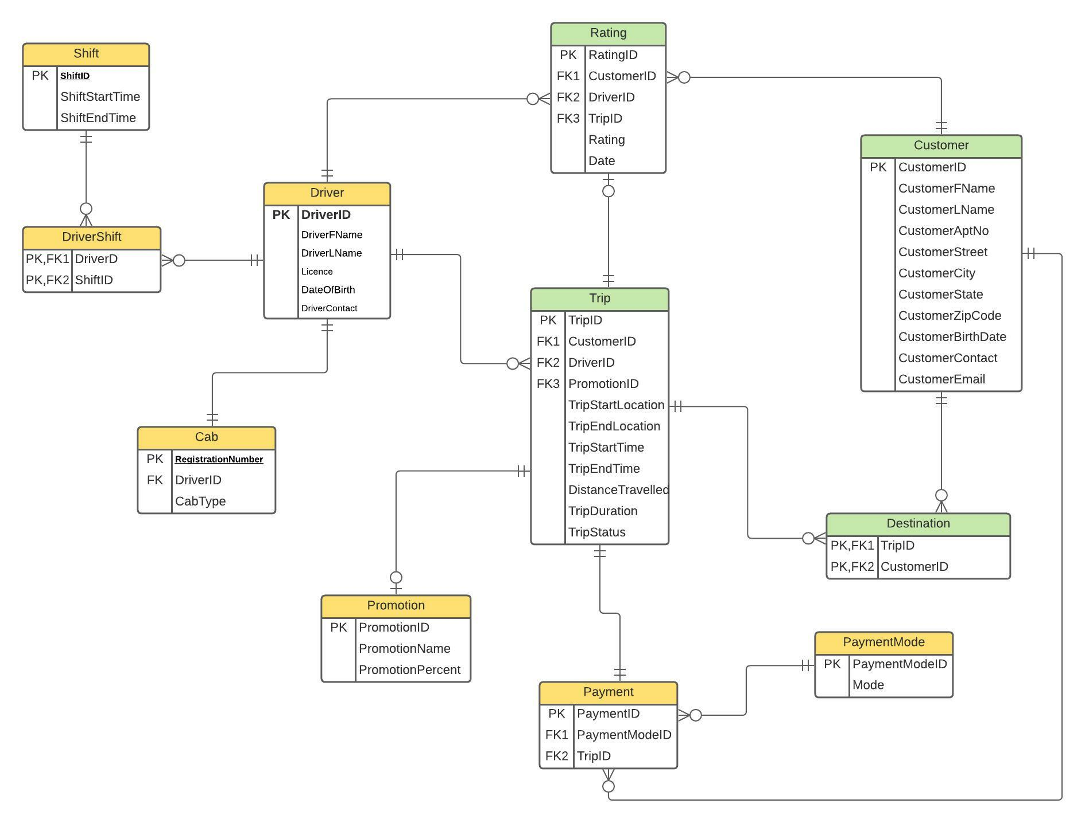

Slide 7
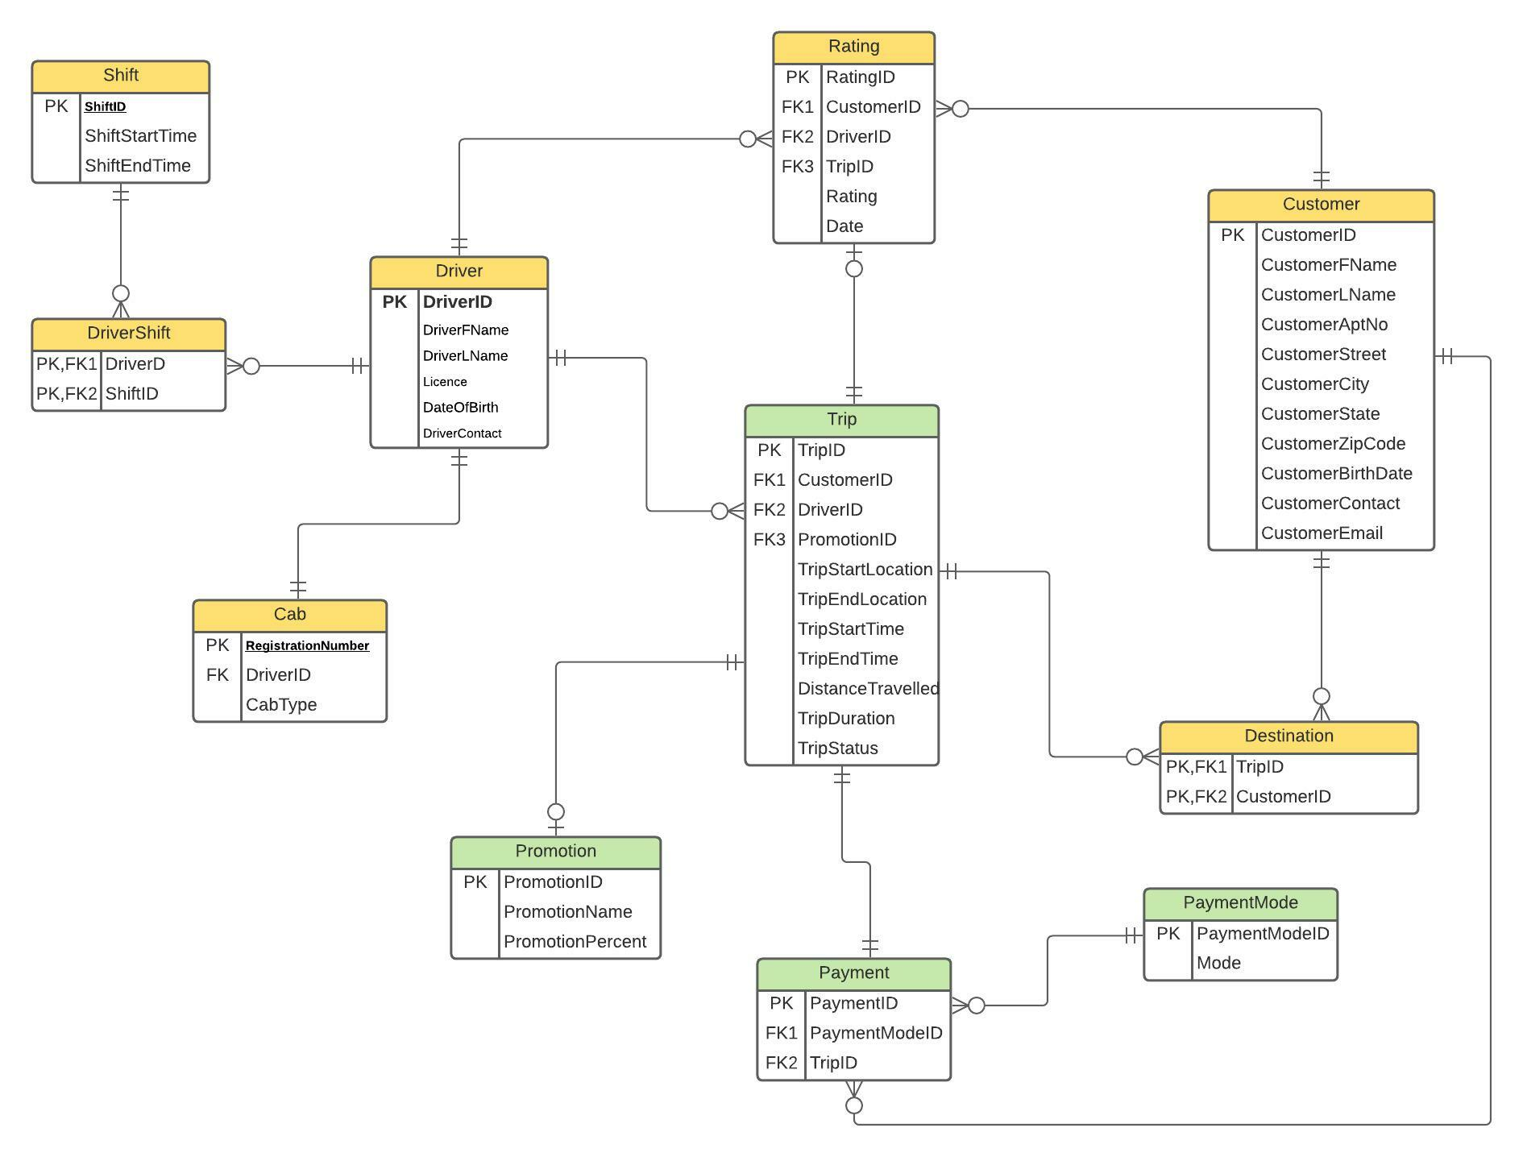

Slide 8
Server- Side Modules
Function-based table-level check constraints
Computed columns
Column data encryption
Non-clustered indexes

Slide 9
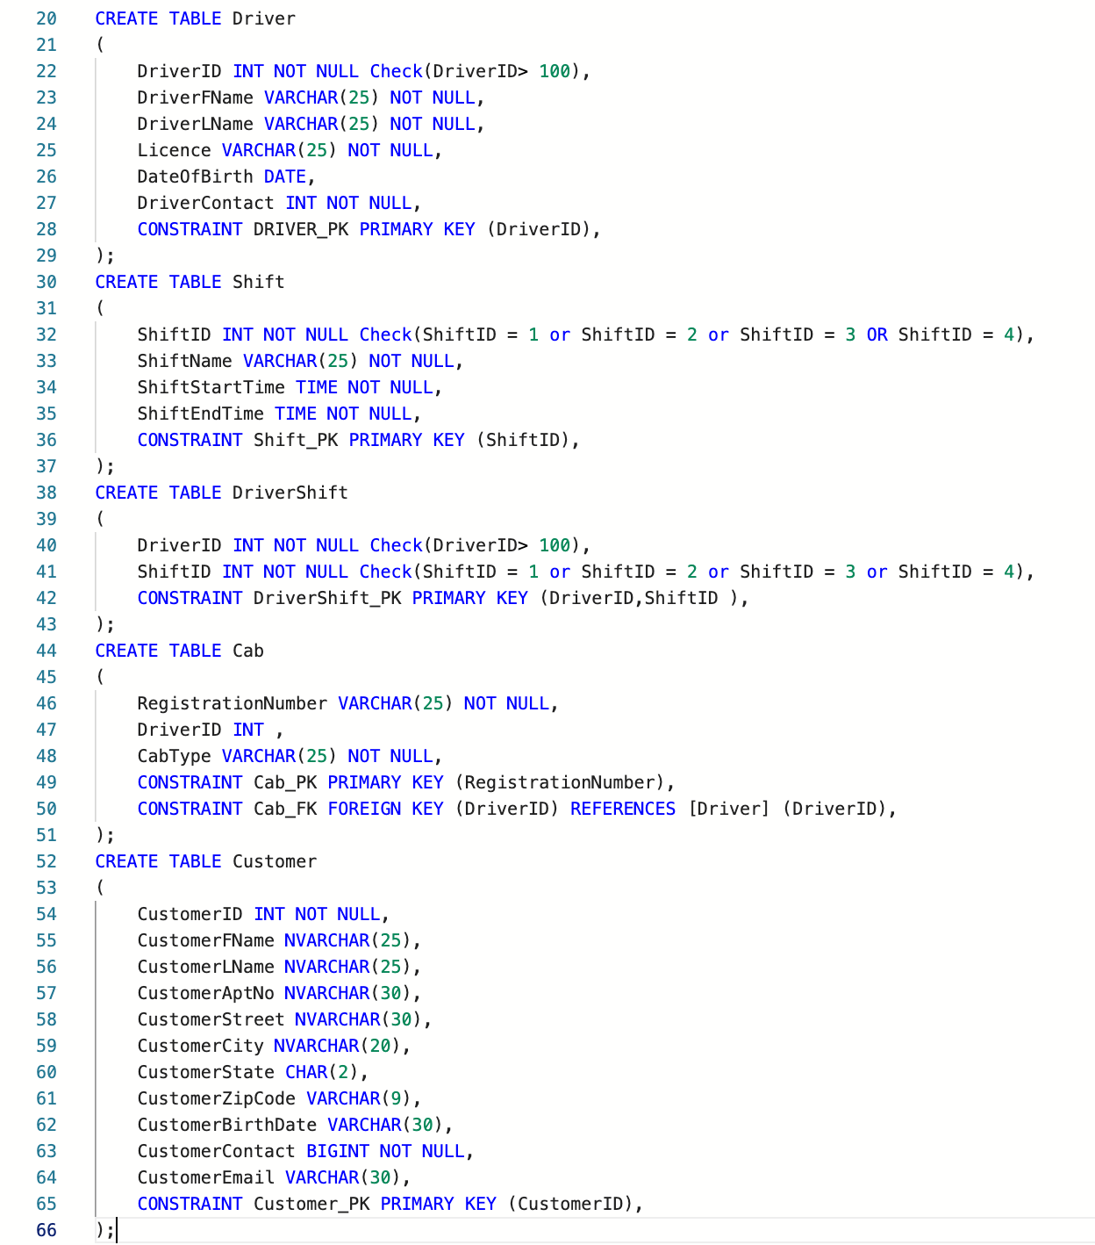
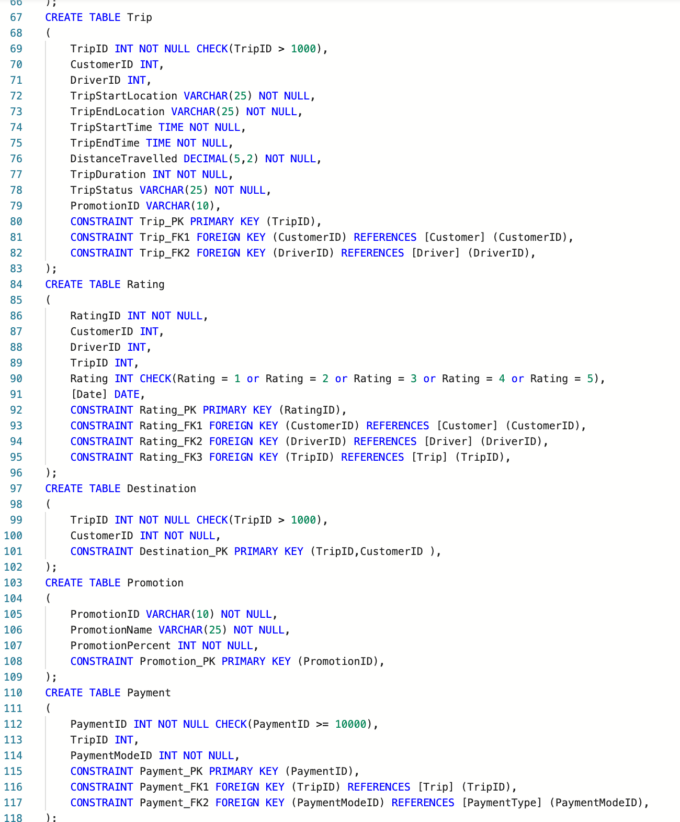
Create Statements

Slide 10
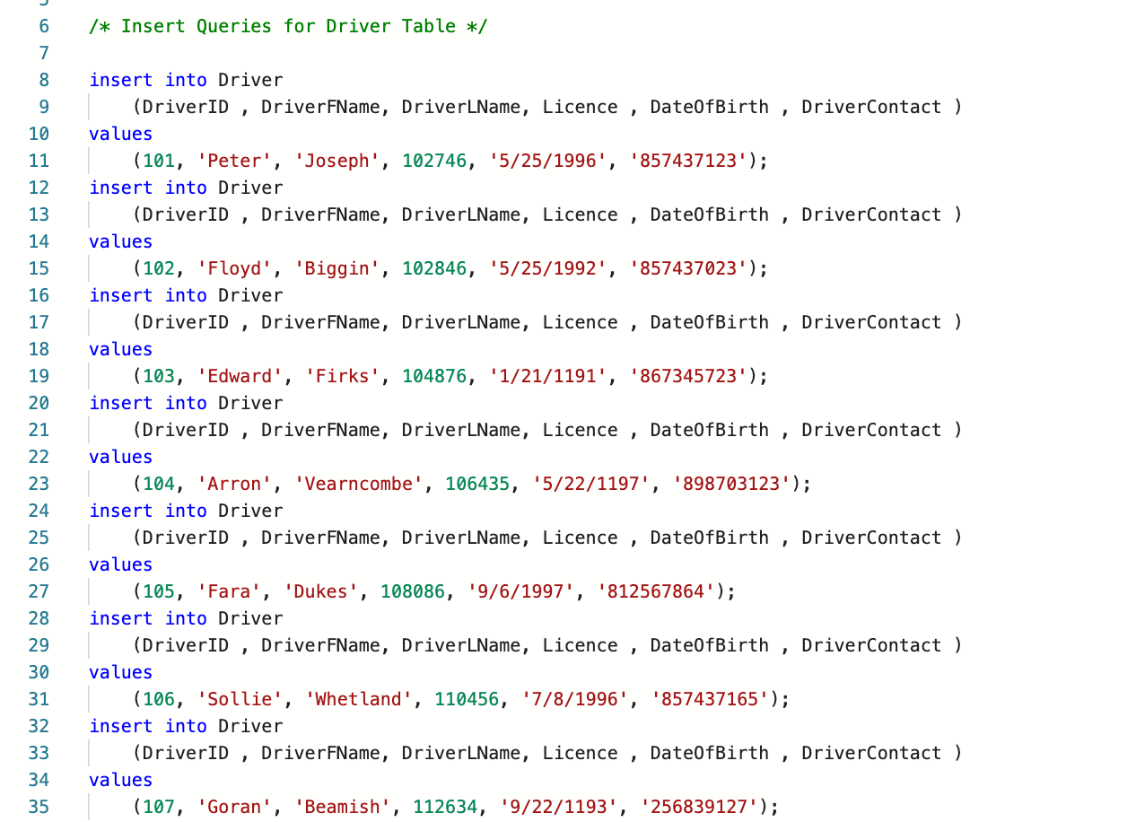
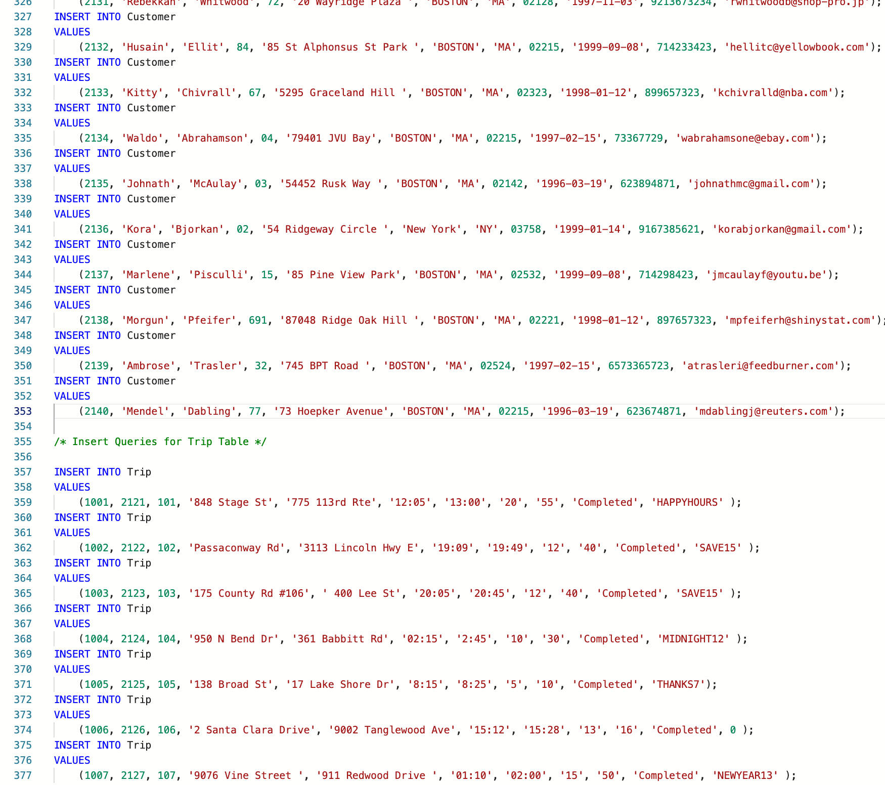
Insert Statements

Slide 11
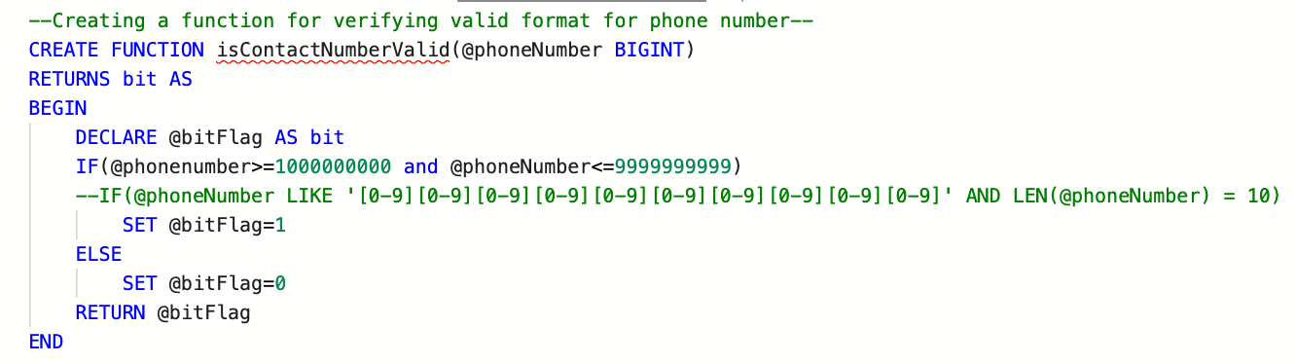
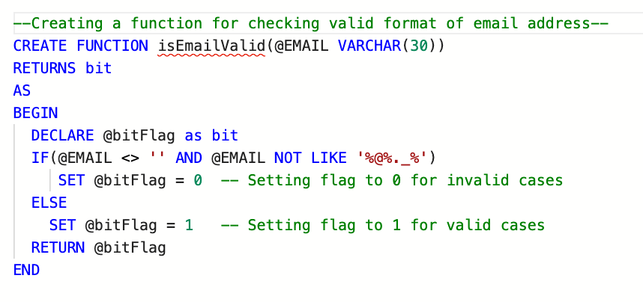
Table level Check Constraints
Email Address​
Valid Email Address Format
Phone Number​
10-digit phone number not starting with 0​

Slide 12
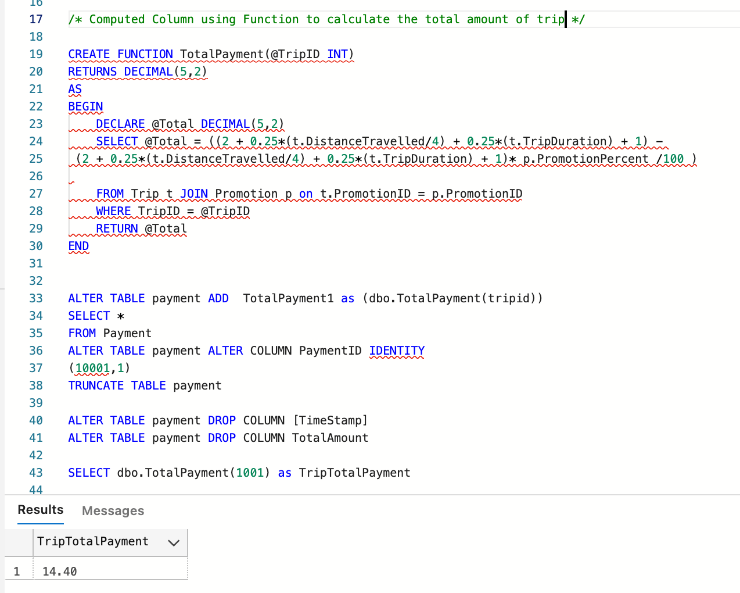
Computed Column
TotalPayment
A function for calculating the total amount of the trip of the customer based on the tripId has been created and the amount gets added into the Trip table

Slide 13
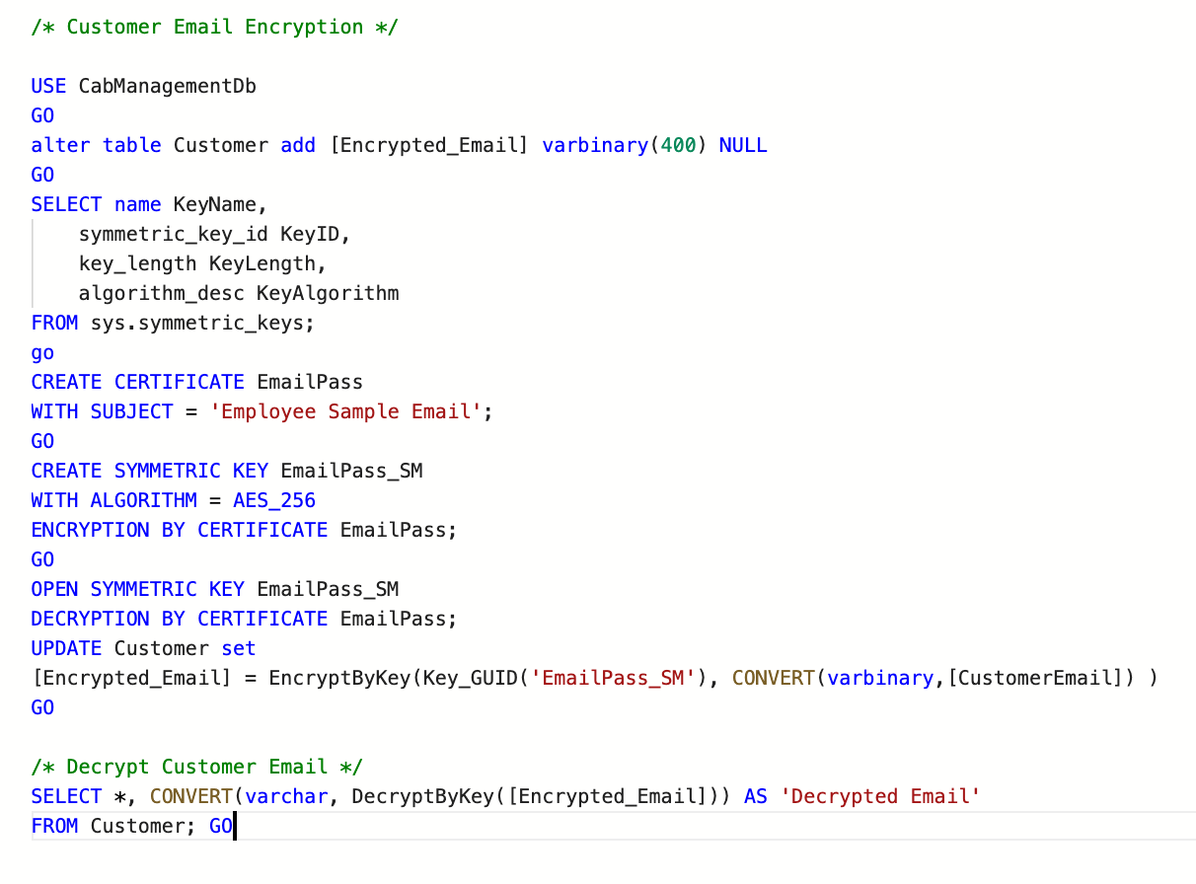
Column Data Encryption
Email Address Encryption
Achieved encryption of email address in Customer table through master key, symmetric key and certificate

Slide 14
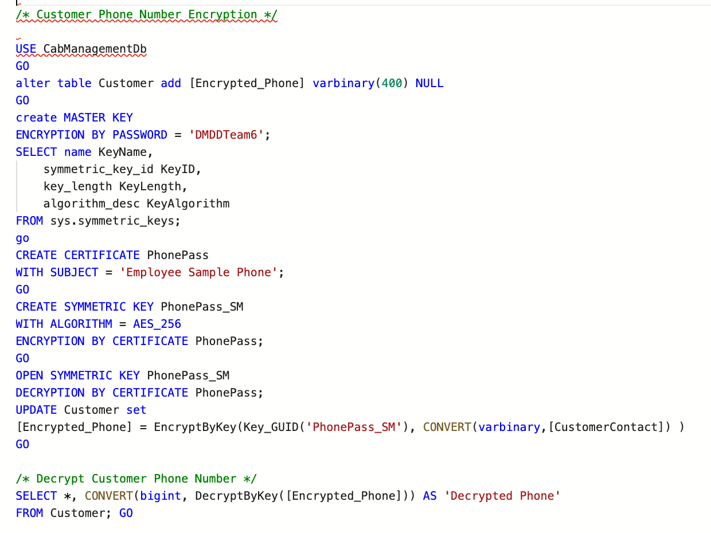
Column Data Encryption
Phone Number Encryption
Achieved encryption of Customer Phone number in Customer table through master key, symmetric key and certificate

Slide 15
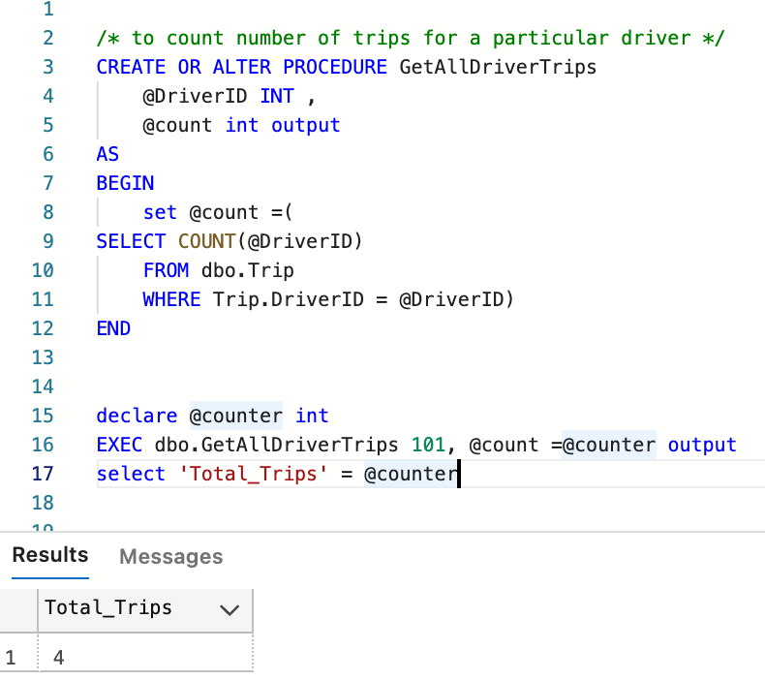
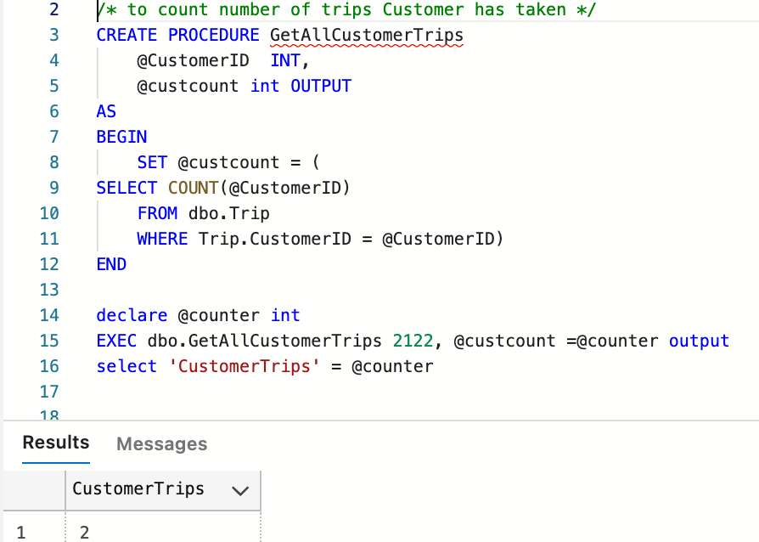
Stored Procedure
GetAllDriverTrips Stored procedure will calculate the Total trips a driver has completed
GetAllCustomerTrips procedure will calculate the total trips Customer has Taken

Slide 16
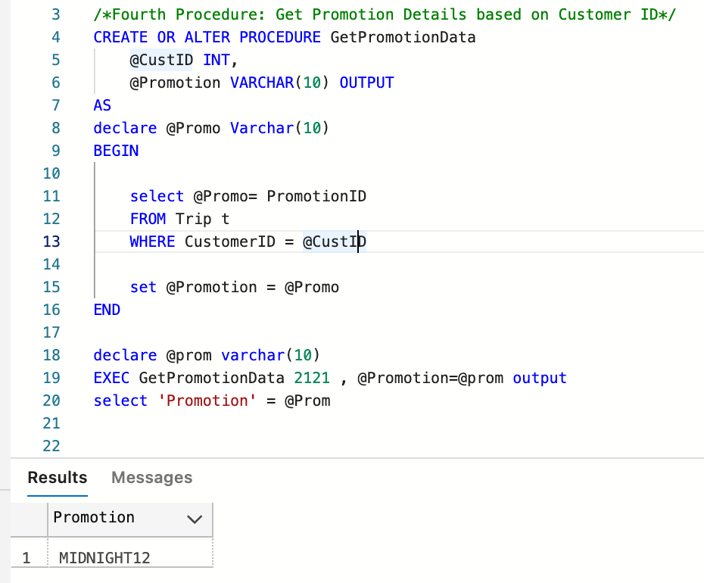
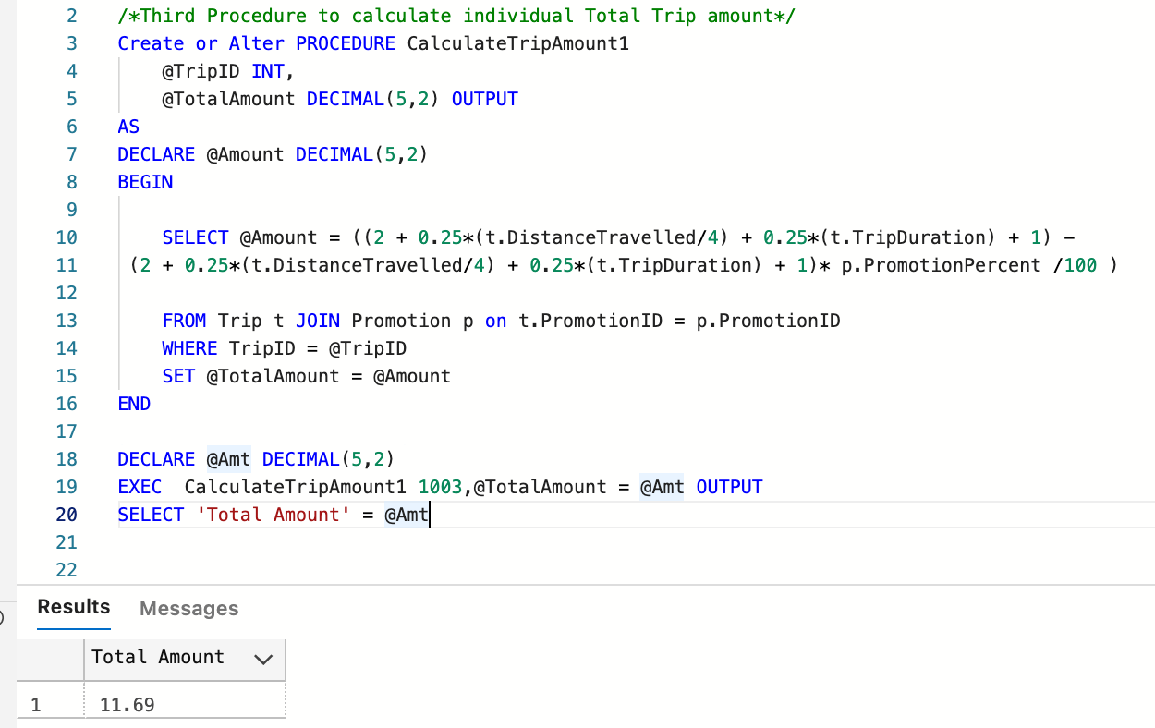
Stored Procedure
GetPromotionData stored procedure will return the promotion Id a customer has used for a particular trip
GetCalculateTripAmount1 Stored Procedure will calculate the Total of a particular trip

Slide 17
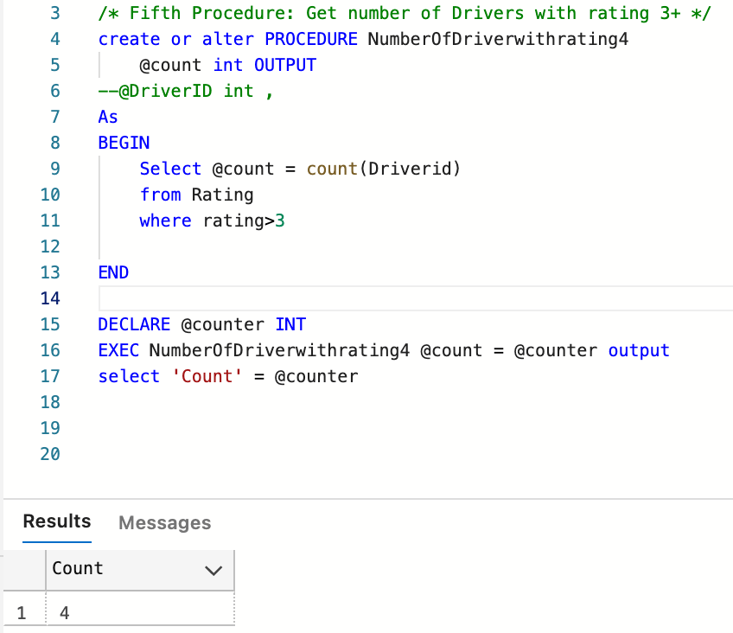
Stored Procedure
NumberOfDriverwithrating Stored Procedure will return the Count of drivers with 3* plus rating

Slide 18
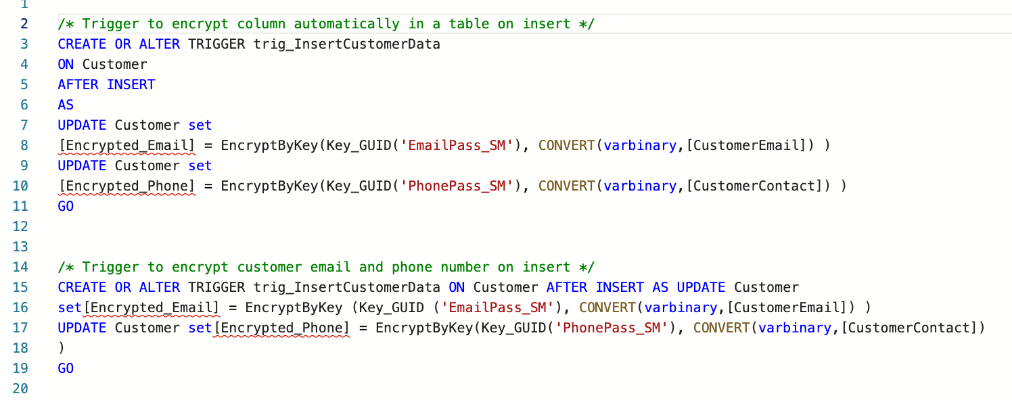
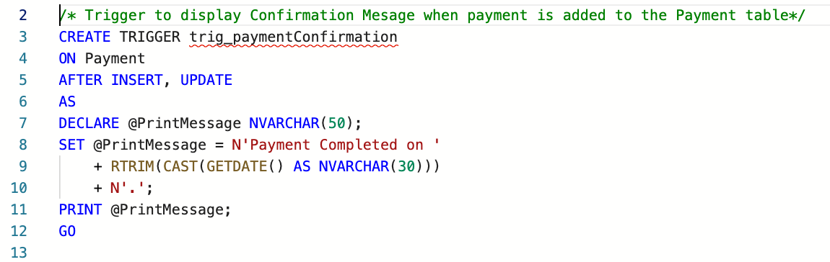
Triggers
Trigger to Automatically encrypt the Customer phone number and email when record is inserted or updated in the table
Trigger to Display. A confirmation message when a payment is completed, and payment is added to the table

Slide 19
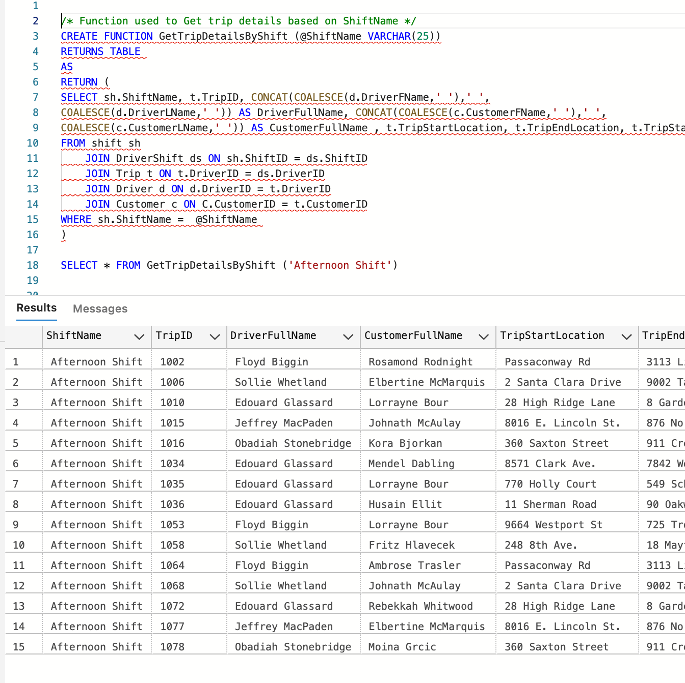
Functions
Function which will return the trip details that were occurred in afternoon shift

Slide 20
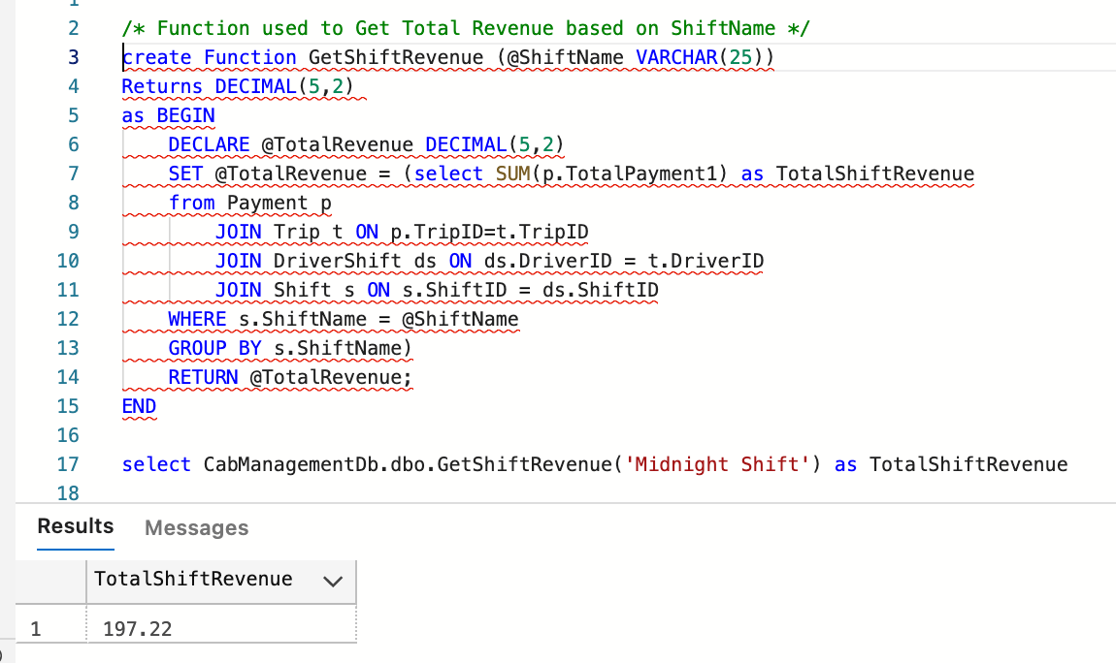
Functions
Function which will calculate the total Revenue based on the provided Shift duration

Slide 21
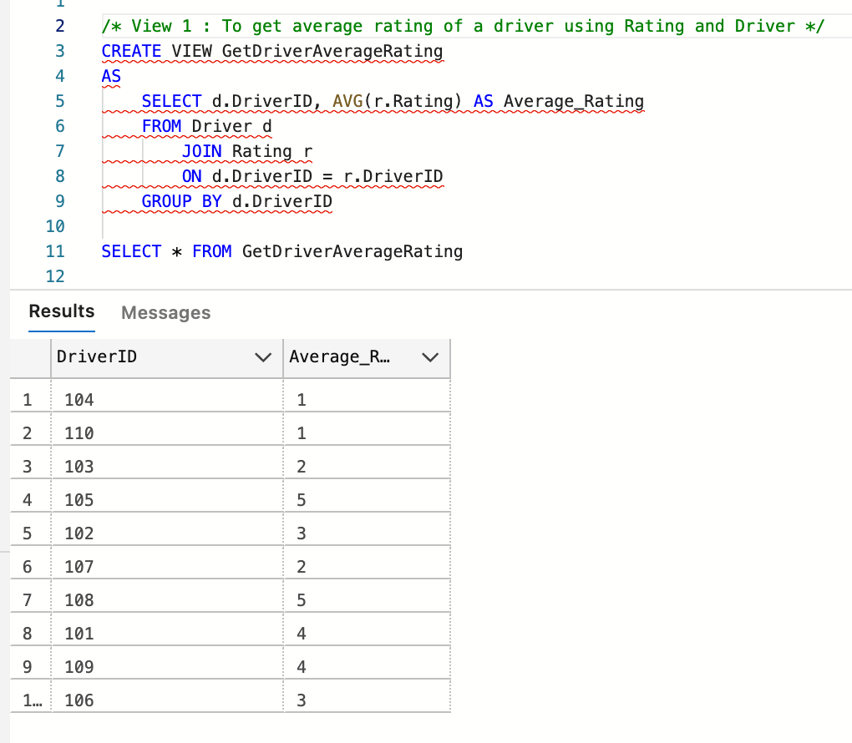
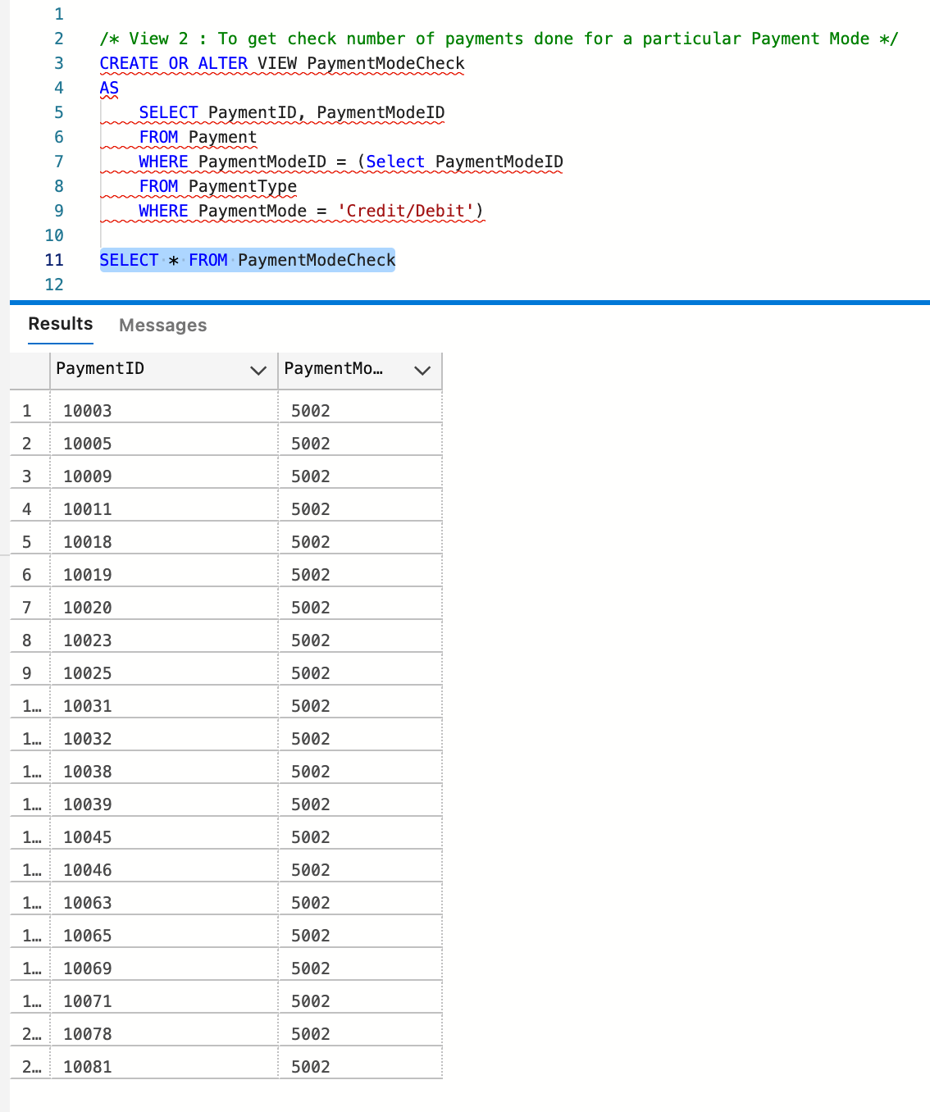
Views
View which calculates the average rating of a driver using Rating and Driver
View which check the number of payments for a particular Payment mode

Slide 22
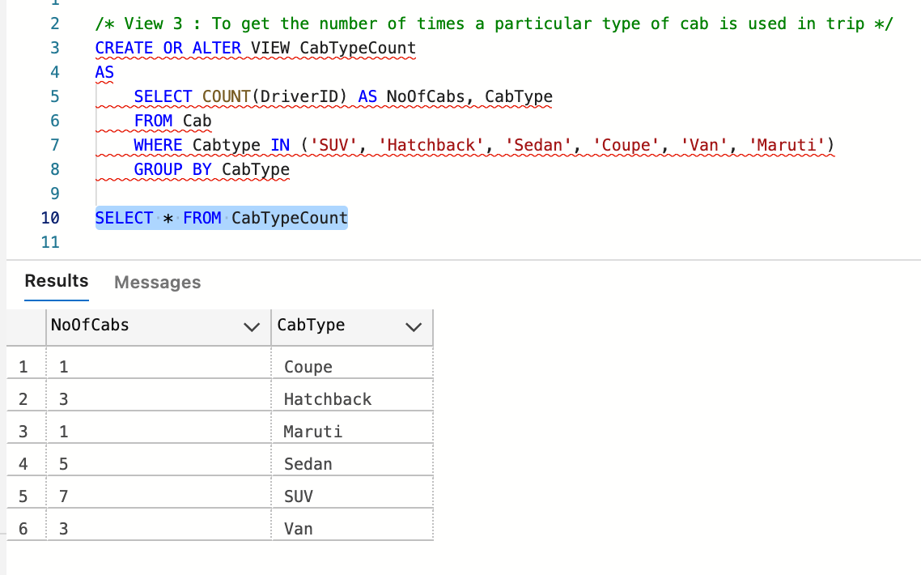
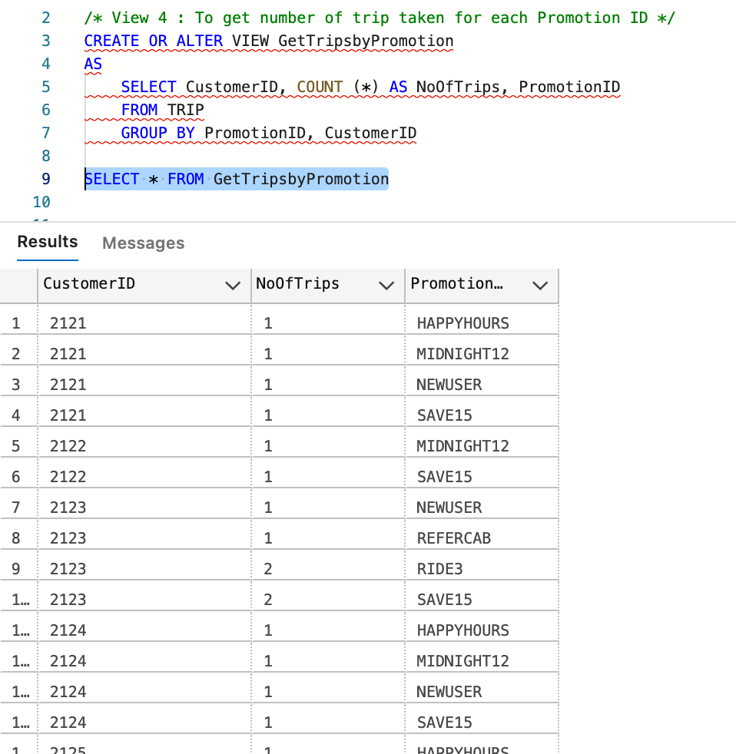
Views
View to get the number of times particular type of cab is used in trip
View to get the number of trip taken for each Promotion ID

Slide 23
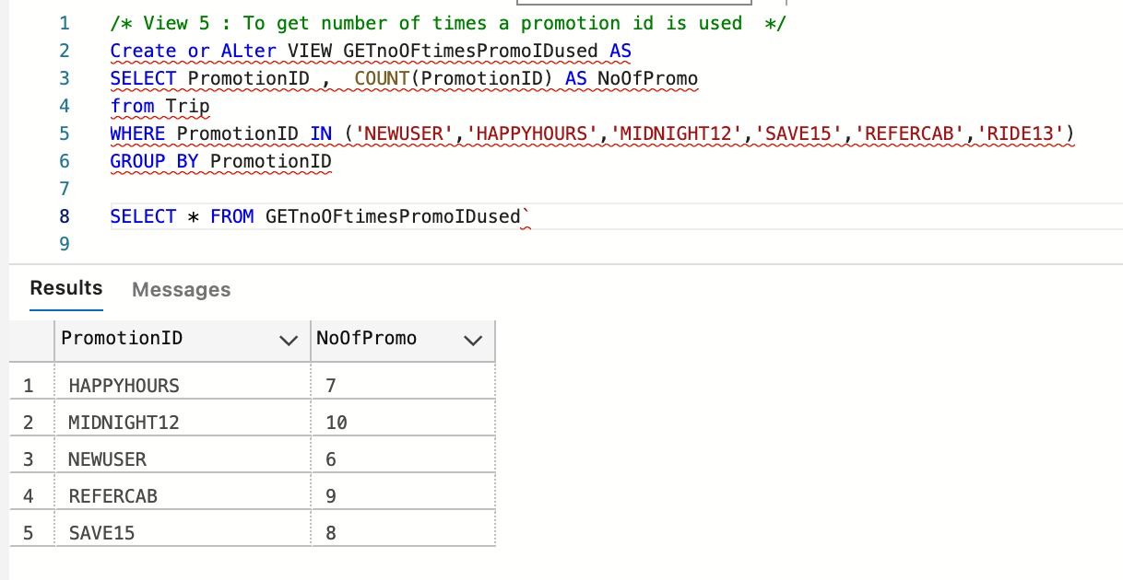
Views
View to get the number of times a promotion ID has been used

Slide 24
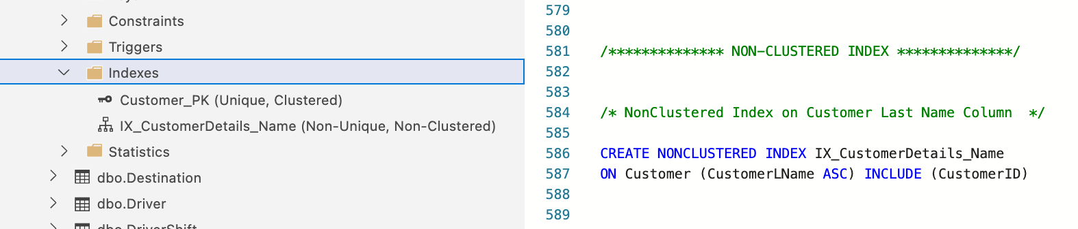
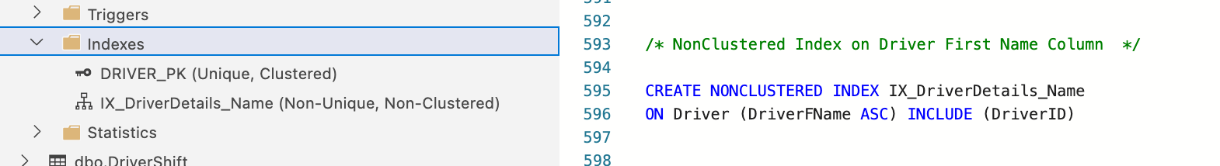
Non-Clustered Indexes
A non-clustered index has been applied for Customer table and Driver table as shown below.

Slide 25
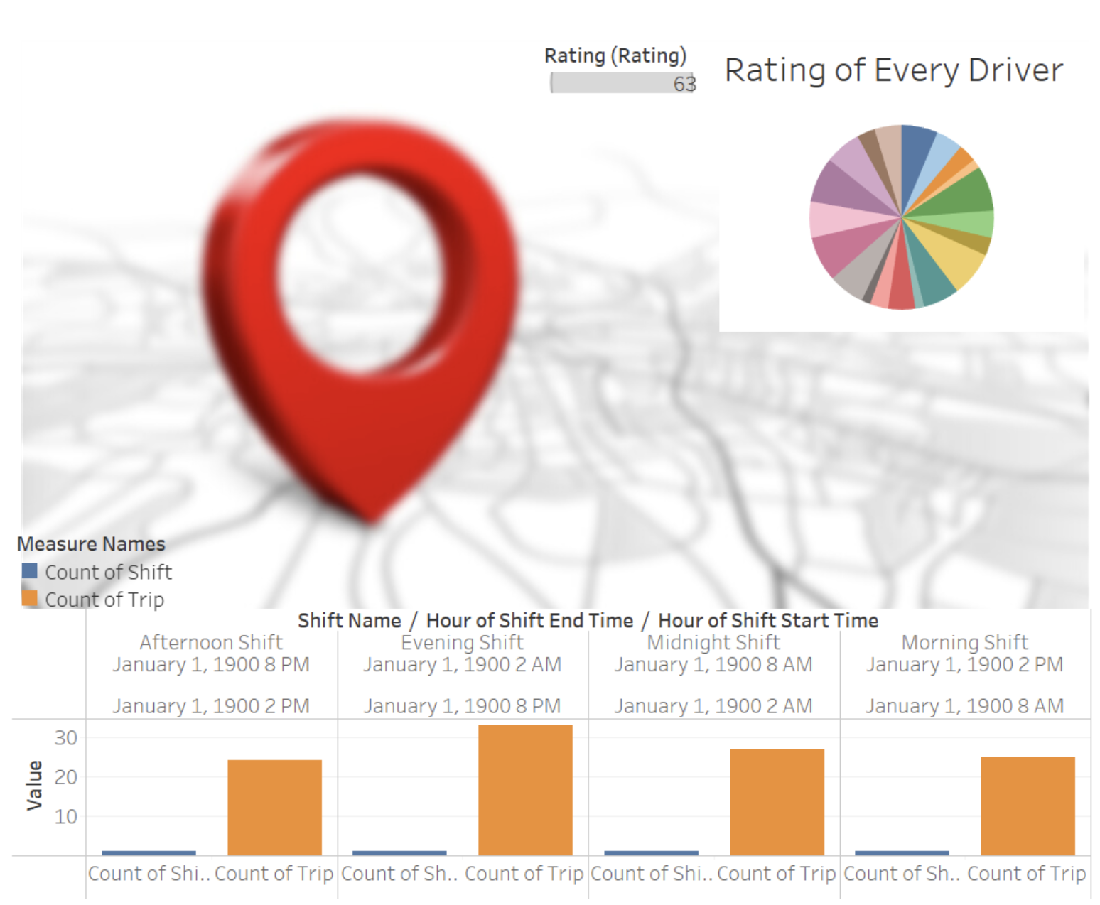
Dashboard

Slide 26
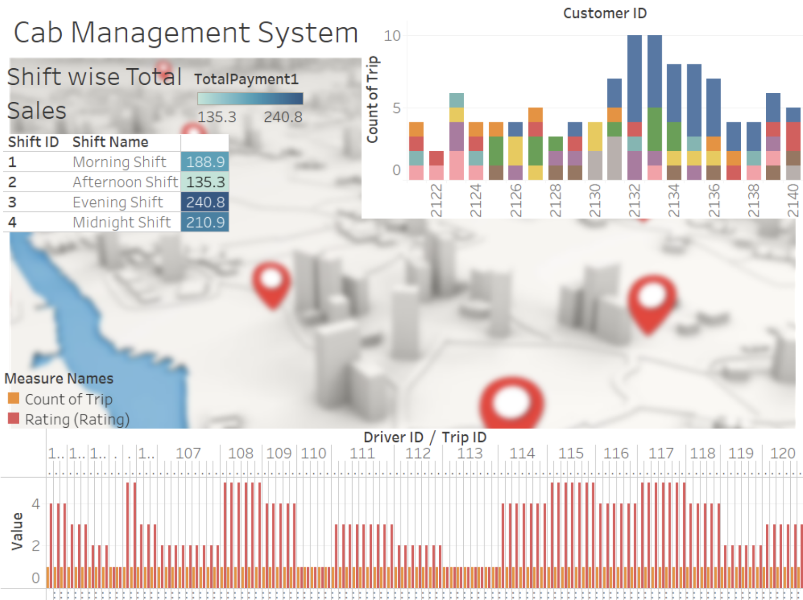
Dashboard

Slide 27
Contribution
Names | Individual Contribution
Rutuja Nitin Mandlik | DDL’s, Table-level check constraints, Trigger, Stored Procedures, Functions, Views, Indexes, Final ERD, Presentation
Nikita Singh | DDL’s, Dashboard using Tableau, Data Population, ERD
Mandar Deshmukh | DDL’s, Column Data Encryption, Data Population, Trigger, Stored Procedures, Views, ERD
Manita Pasi | DDLs, Column Data Encryption, Stored Procedures, Views, Data Population, ERD

Slide 28
Project link
https://drive.google.com/drive/folders/1tIYZJHBm_zgdqlJ7h-MpBFLNdKCFTdH5?usp=sharing
https://drive.google.com/file/d/1AsR6e6UkMhpjPR2xME6Mt6iPZy5LOORe/view?usp=sharing

Slide 29

Thank you!

